Slide 1
Machine Learning and Deep Learning

Slide 2
In Simple Terms...
Initially, a child doesn’t know anything.
We train them like an animal walks on 4 legs whereas a man(human) walks on 2 legs.
We train them giving examples and showing pictures.
So when the child see a living thing next time which is on 4 legs it recognizes as an animal.
Similarly, we train machine(train model) by giving data so that it can give output (predict) the next time.

Slide 3
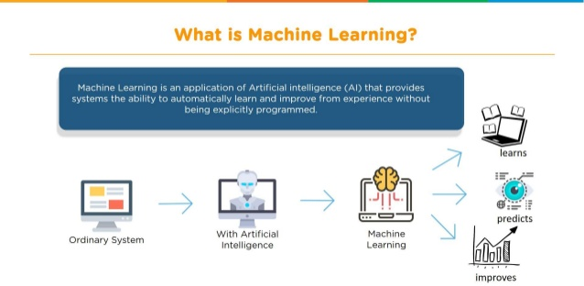
What is ML?

Slide 4
Types of ML
1. Supervised Learning- Where the labelled data is given for training –Regression and Classification
2. Unsupervised Learning-Where Unlabelled data is given for training-Clustering and association rules
3. Reinforcement Learning- there is no fixed training dataset, rather a goal or set of goals that an agent is required to achieve, actions they may perform, and feedback about performance toward the goal.

Slide 5
Supervised Learning :
Supervised learning is when the model is getting trained on a labelled dataset. Labelled dataset is one which have both input and output parameters.

Slide 6
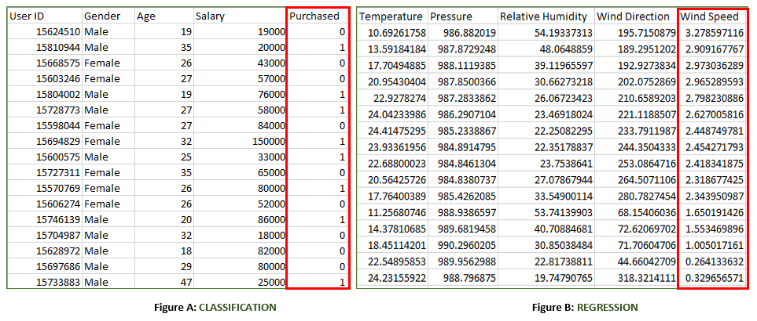
Figure A: It is a dataset of a shopping store which is useful in predicting whether a customer will purchase a particular product under consideration or not based on his/ her gender, age and salary. Input : Gender, Age, Salary Output : Purchased i.e. 0 or 1 ; 1 means yes the customer will purchase and 0 means that customer won’t purchase it.
Figure B: It is a Meteorological dataset which serves the purpose of predicting wind speed based on different parameters. Input : Dew Point, Temperature, Pressure, Relative Humidity, Wind Direction Output : Wind Speed

Slide 7
Training the system: While training the model, data is usually split in the ratio of 80:20 i.e. 80% as training data and rest as testing data. In training data, we feed input as well as output for 80% data. The model learns from training data only. We use different machine learning algorithms(which we will discuss in detail in next articles) to build our model. By learning, it means that the model will build some logic of its own. Once the model is ready then it is good to be tested. At the time of testing, input is fed from remaining 20% data which the model has never seen before, the model will predict some value and we will compare it with actual output and calculate the accuracy.
Types of Supervised Learning:
Classification : It is a Supervised Learning task where output is having defined labels(discrete value). For example in above Figure A, Output – Purchased has defined labels i.e. 0 or 1 ; 1 means the customer will purchase and 0 means that customer won’t purchase. The goal here is to predict discrete values belonging to a particular class and evaluate on the basis of accuracy. It can be either binary or multi class classification. In binary classification, model predicts either 0 or 1 ; yes or no but in case of multi class classification, model predicts more than one class. Example: Gmail classifies mails in more than one classes like social, promotions, updates, forum.
Regression : It is a Supervised Learning task where output is having continuous value. Example in above Figure B, Output – Wind Speed is not having any discrete value but is continuous in the particular range. The goal here is to predict a value as much closer to actual output value as our model can and then evaluation is done by calculating error value. The smaller the error the greater the accuracy of our regression model.

Slide 8
Types of ML Algo.s
Traditional ML Algo.s – Simple ML : Which generally uses structured data(relational tables , etc)
It was difficult to process semi-structured and unstructured data (music , pictures , etc) so deep learning emerged....
Deep learning is a subset of machine learning in artificial intelligence (AI) that has networks capable of learning unsupervised from data that is unstructured or unlabeled.

Slide 9
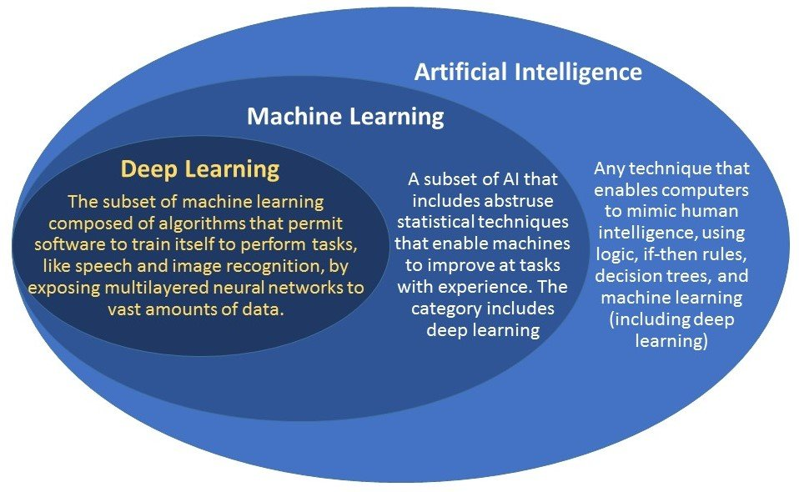

Slide 10
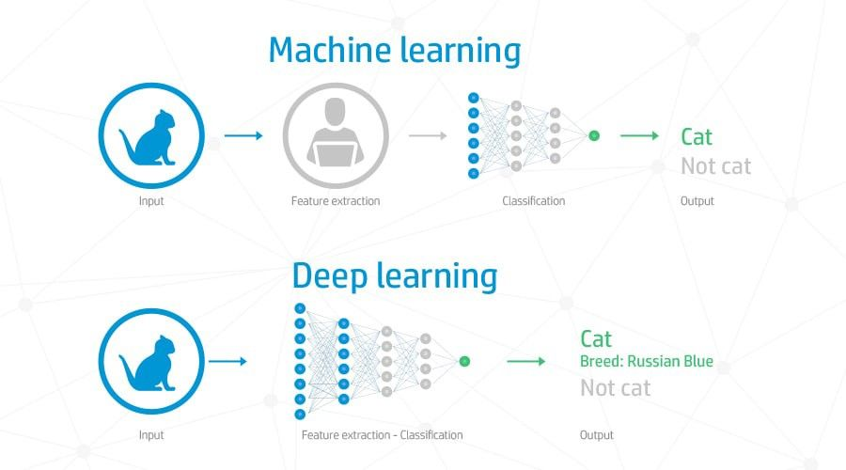
Why DL...

Slide 11
The key difference between deep learning vs machine learning stems from the way data is presented to the system. Machine learning algorithms almost always require structured data, whereas deep learning networks rely on layers of the ANN (artificial neural networks).
Deep learning networks do not require human intervention as the nested layers in the neural networks put data through hierarchies of different concepts, which eventually learn through their own errors. However, even these are subject to flawed outputs if the quality of data isn’t good enough.
Data is the governor here. It is the quality of data which ultimately determines the quality of the result.

Slide 12
NN
Neural networks are the workhorses of deep learning. And while they may look like black boxes, deep down they are trying to accomplish the same thing as any other model — to make good predictions.
Neural networks are multi-layer networks of neurons (the blue and magenta nodes in the chart below) that we use to classify things, make predictions, etc. Below is the diagram of a simple neural network with five inputs, 5 outputs, and two hidden layers of neurons.

Slide 13
